Slide 1





EMSE 6575
PREDICTING IPL MATCH OUTCOMES
A Data Science Approach

Slide 2



Presentation
Outline
ITEMS TO DISCUSS
Introduction
Understanding the Data
Exploratory Data Analysis (EDA)
Feature Engineering
Model Building and Evaluation
Visualization

Slide 3

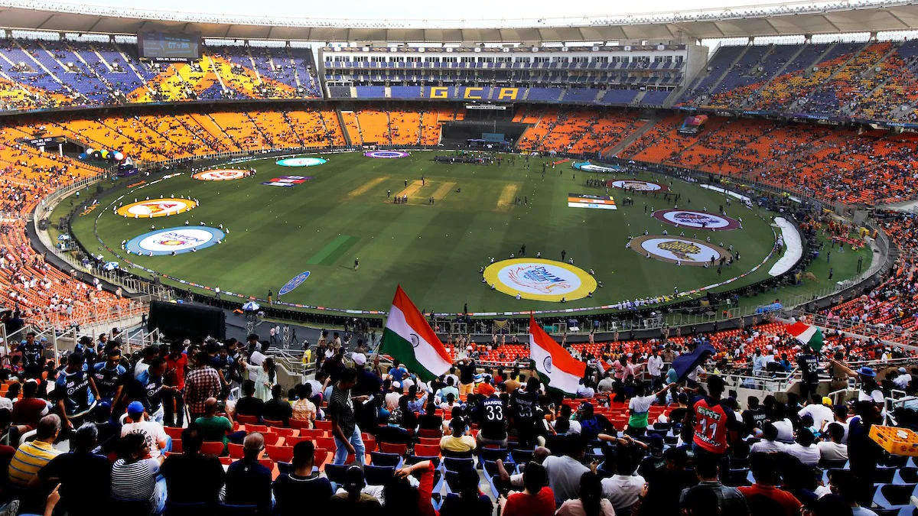
About Cricket
Explaining the Game of Cricket

Slide 4

Understanding the Data:

Slide 5
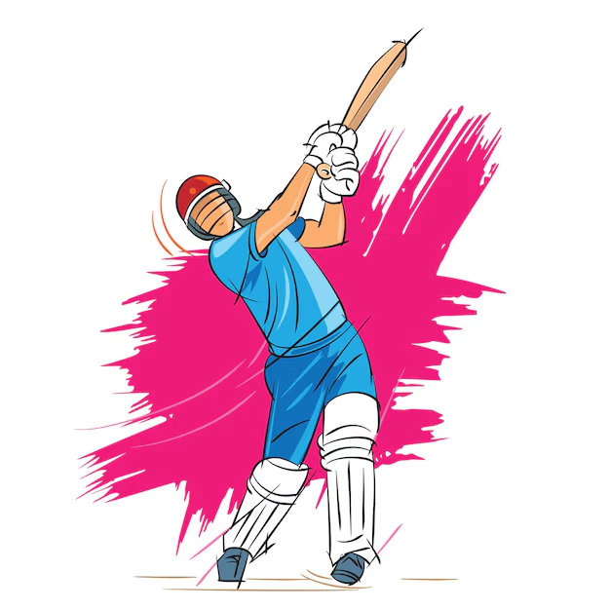
Two Datasets
Matches Dataset
Dataset Consists of all match data like Season, city, team1, team2, toss_winner, winner, win_by_runs, etc
Deliveries Dataset
Dataset consists of all individual delivery data of all matches like inning, batting_team, bowling_team. over, ball, batsman, non_striker etc.

Slide 6
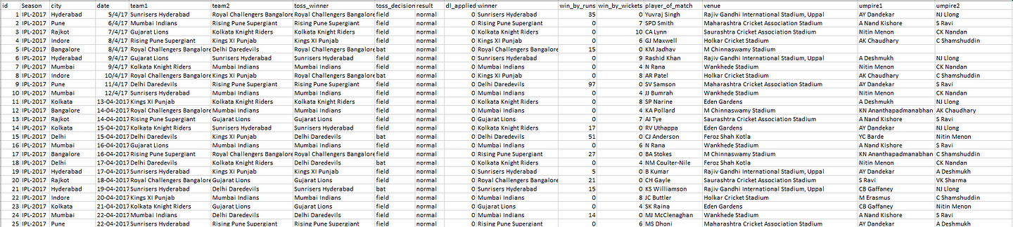
Matches Dataset
Refer the Code: Dataset

Slide 7
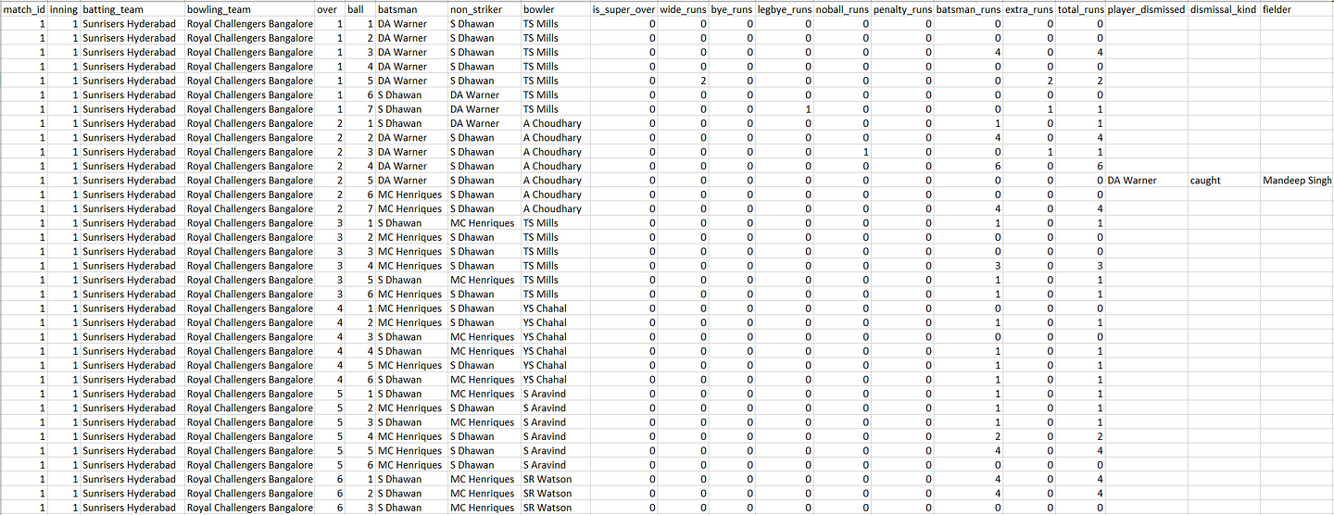
Deliveries Dataset

Slide 8
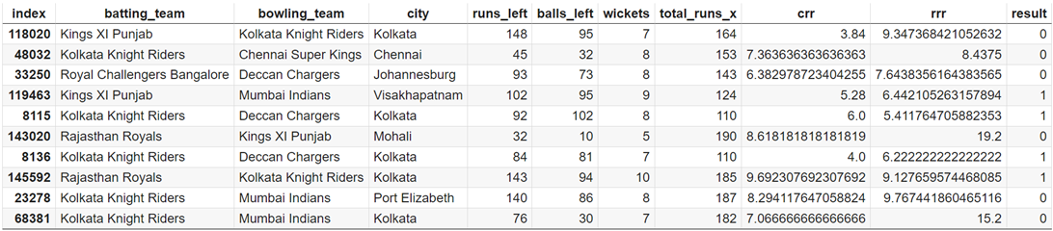
Final Dataframe

Slide 9

DATA CLEANING AND PROCESSING
It first calculates the total runs scored in each inning of every match and plots histograms for the distribution of total runs scored in the first and second innings separately. Then, it adds the total runs scored in each match to the matches dataframe.
Next, it prepares the match dataframe by replacing outdated team names with current ones and filtering out matches involving only the main IPL teams. It further filters out matches where the Duckworth-Lewis method was applied.
Finally, it merges the matches and deliveries dataframes on the match ID, resulting in a dataframe containing details of each delivery in the second inning of every match.
Code Reference: Cleaning

Slide 10
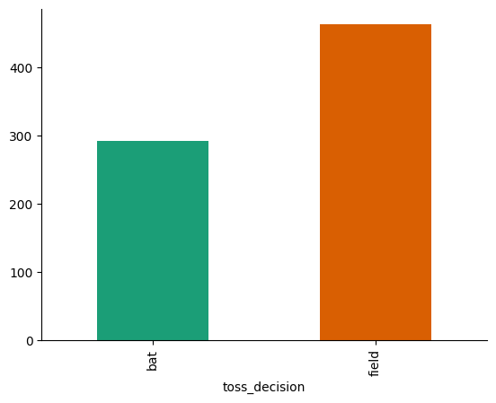
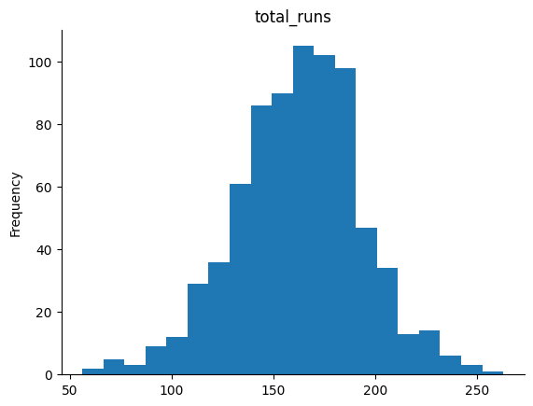


Slide 11
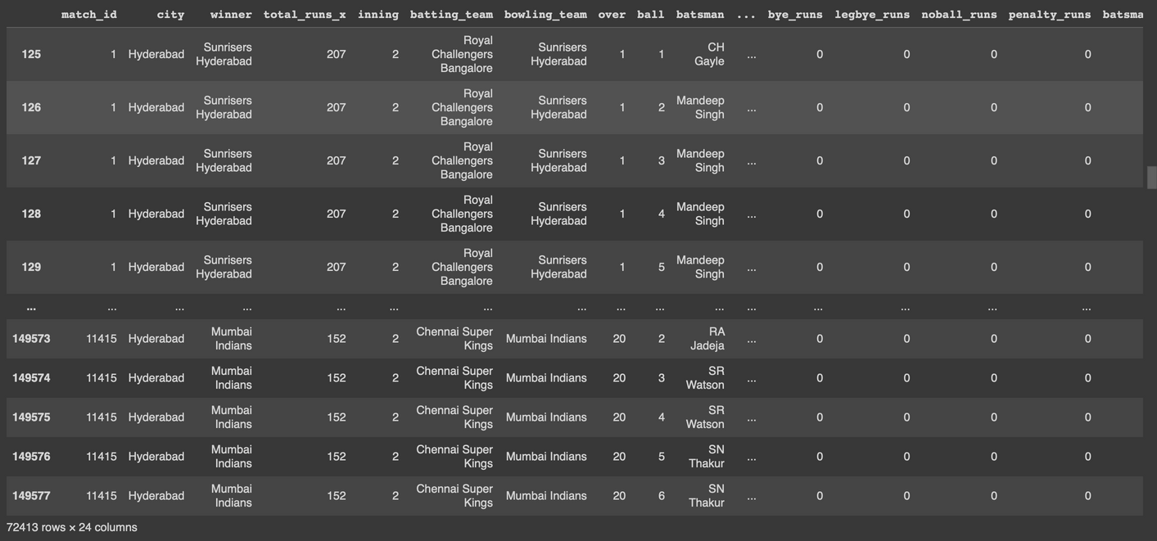
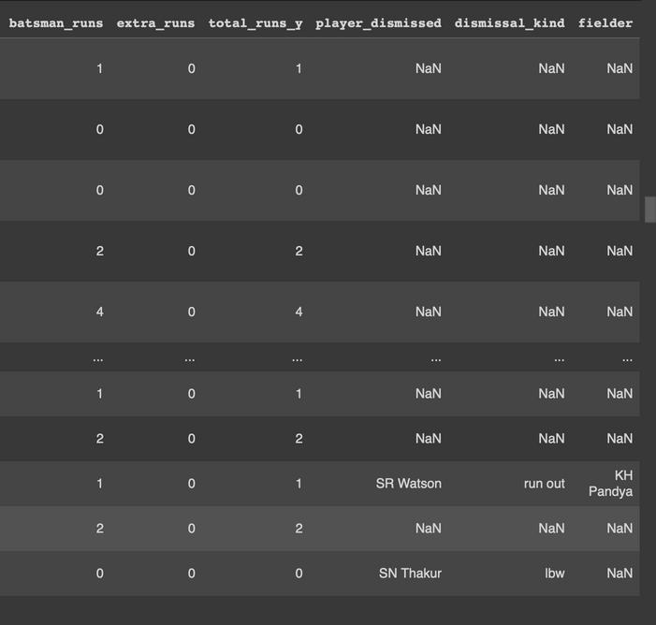
Output after Data Cleaning

Slide 12

FEATURE ENGINEERING
1. Cumulative Score Calculation: The code computes the cumulative score after each ball (`current_score`) and the runs left to chase (`runs_left`) in a cricket match.
2. Remaining Balls Calculation: It calculates the remaining balls to be bowled (`balls_left`) based on the over and ball information.
3. Wickets Calculation: The code tracks the number of wickets fallen (`wickets`) in the match, considering a maximum of 10 wickets per innings.
4. Run Rate Engineering: It derives the current run rate (`CRR`) and required run rate (`RRR`) based on the current score, remaining balls, and runs left.
5. Match Result Prediction: A function `result()` is defined to determine if the batting team wins (`result = 1`) or loses (`result = 0`) the match based on the winner and batting team.
6. Compilation of Final Dataset: The final dataframe `final_df` is created, containing essential features like batting team, bowling team, city, runs left, balls left, wickets, CRR, RRR, and the match result. Any rows with missing values are removed from this dataset.
Code Reference: Feature Engineering

Slide 13
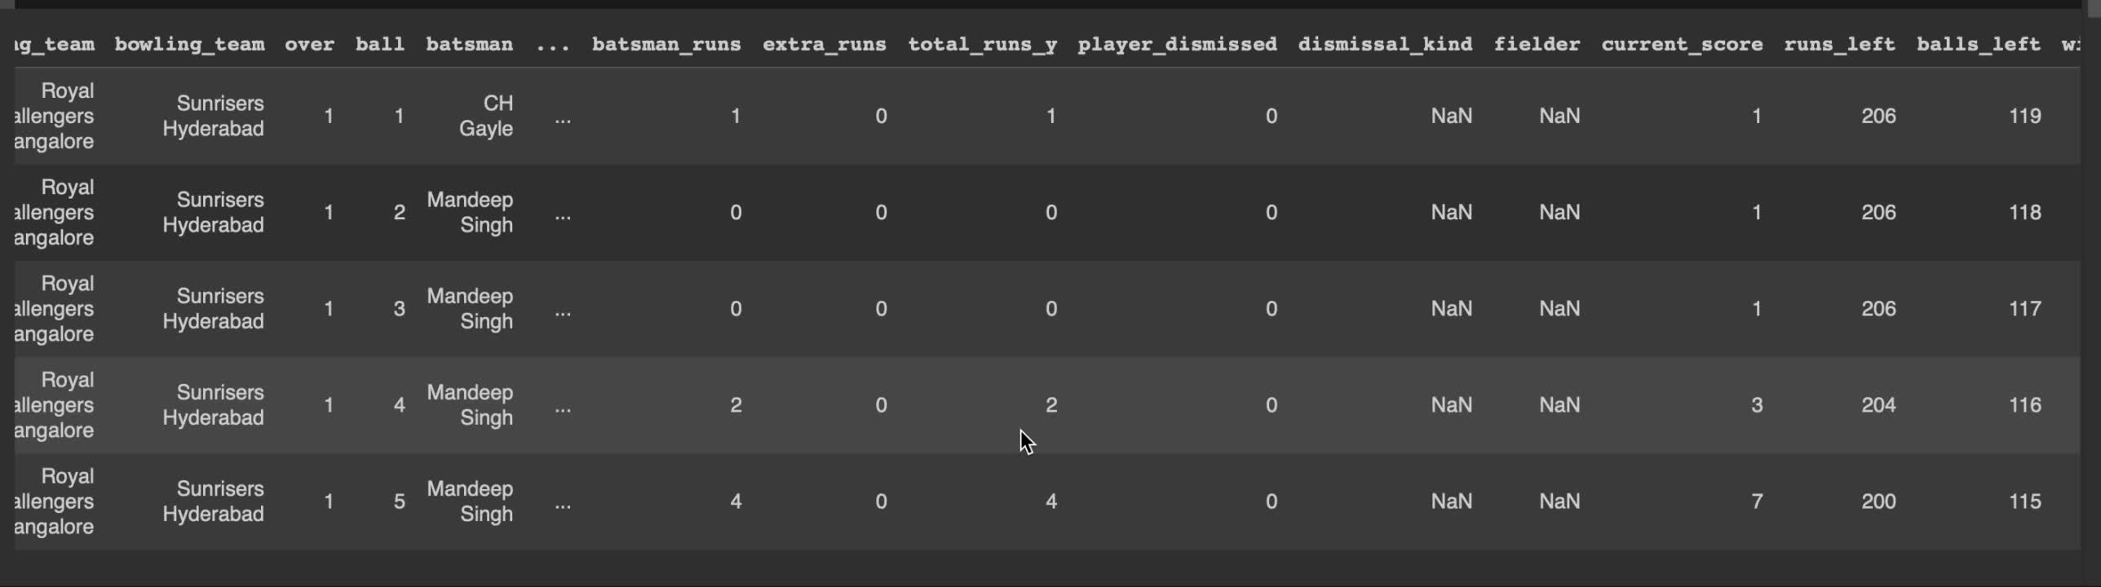
Dataset after feature engineering

Slide 14
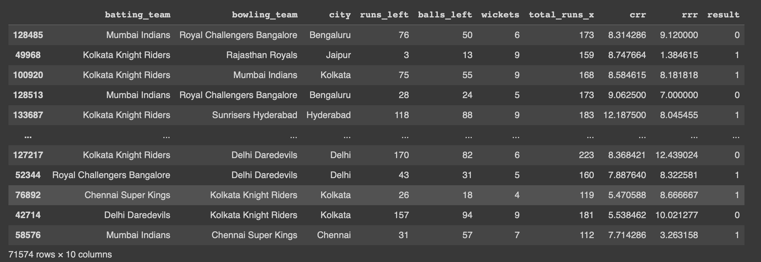
Final data frame prepared for EDA and machine learning :

Slide 15
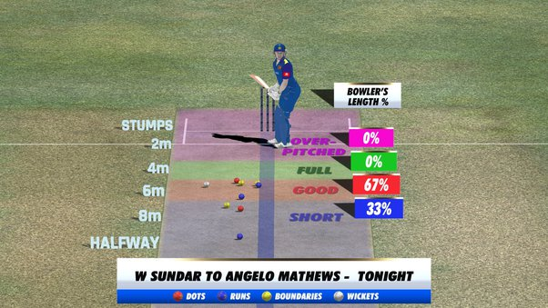
EXPLORATORY DATA ANALYSIS
Code Reference: EDA

Slide 16
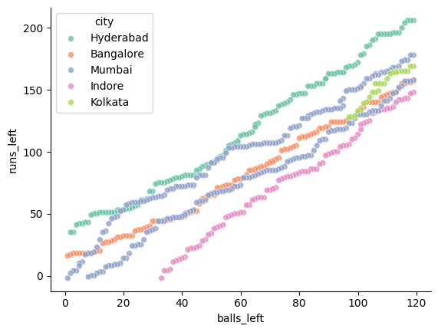

Slide 17
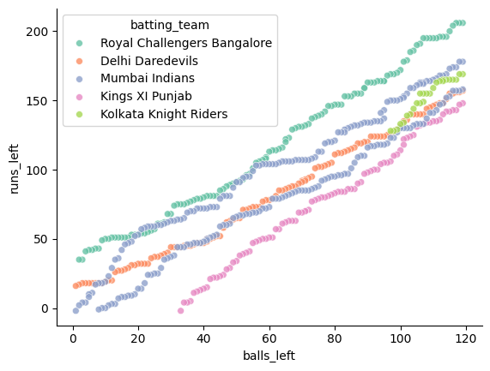
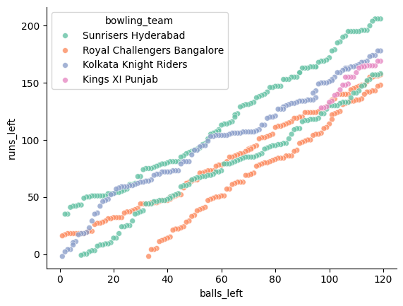

Slide 18
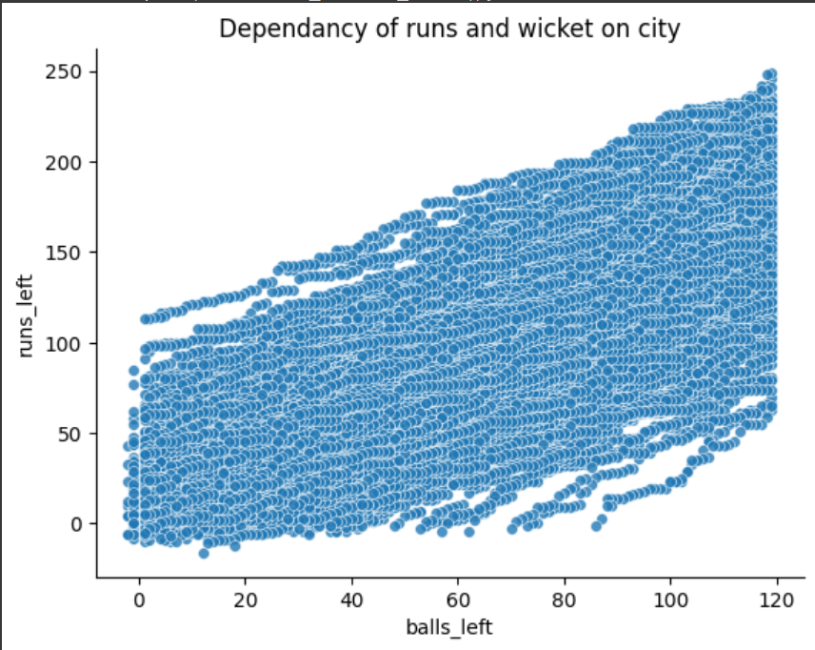

Slide 19
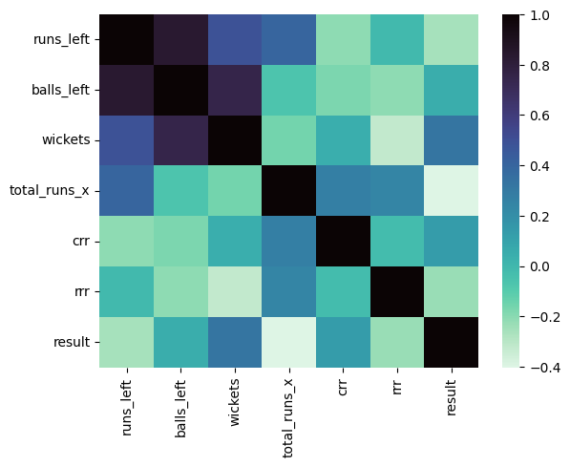

Slide 20
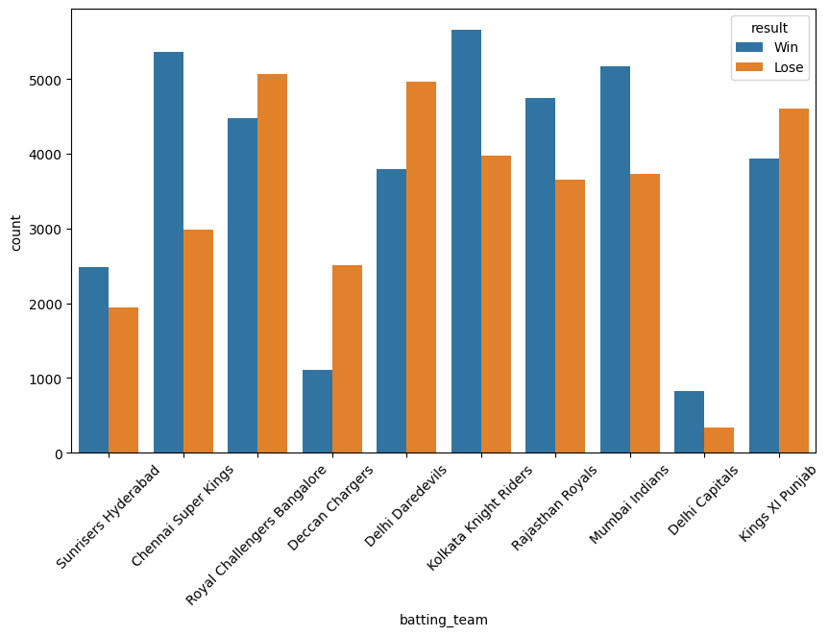

Slide 21
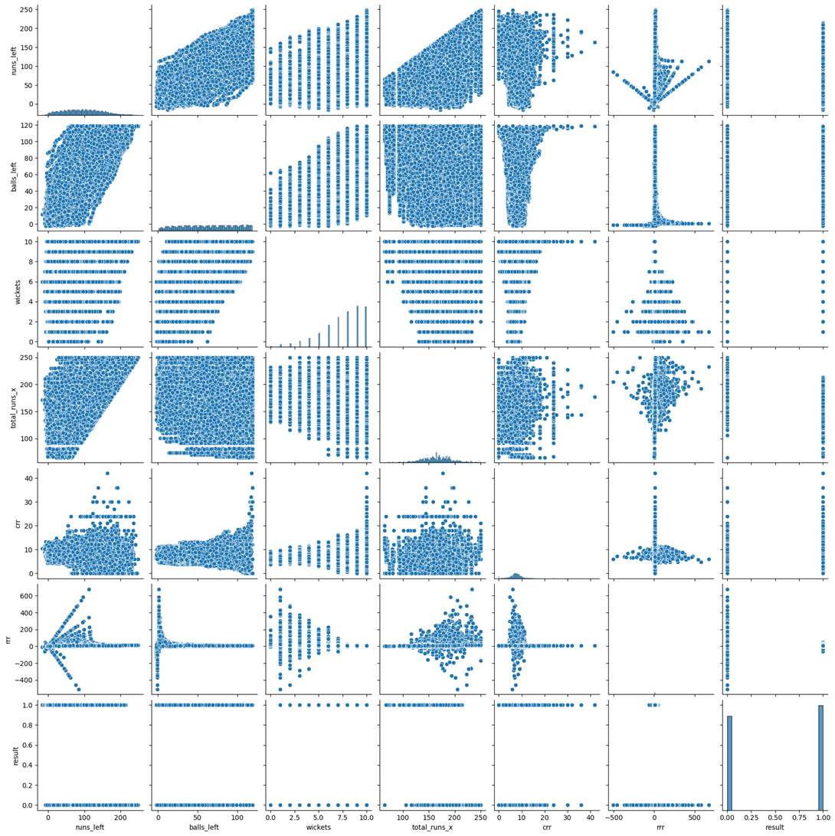

Slide 22
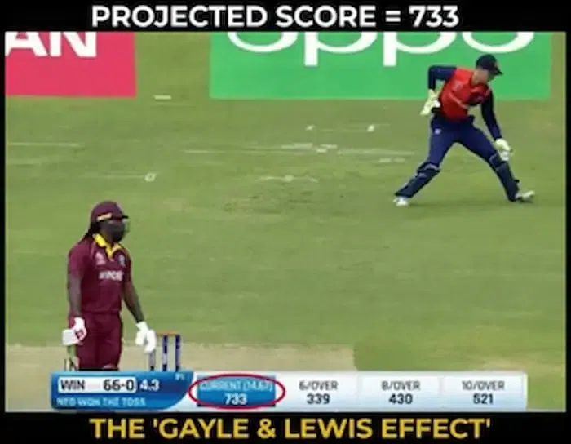
MACHINE LEARNING AND PREDICITON
Code Reference: ML

Slide 23
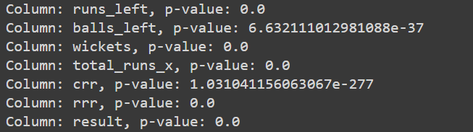
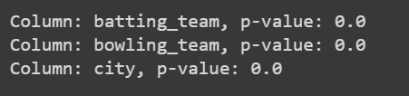
PEARSON CORRELATION
CHI SQUARED TEST

Slide 24
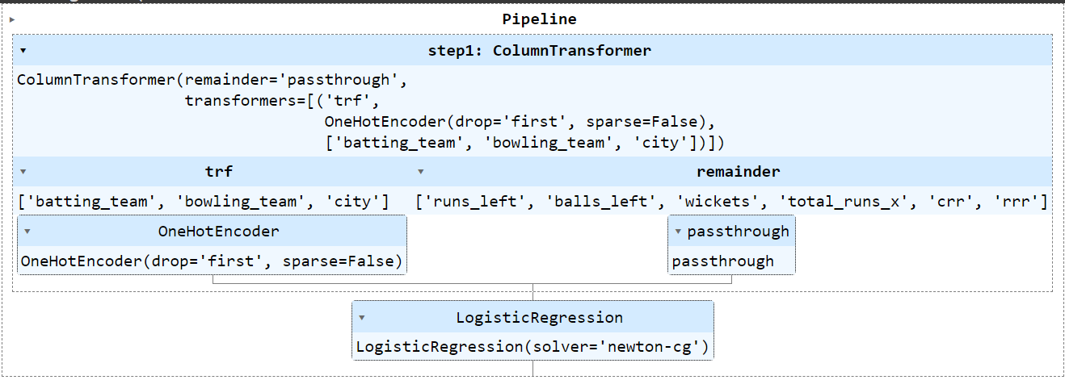
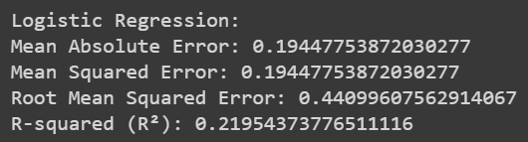
LOGISTIC REGRESSION MODEL

Slide 25
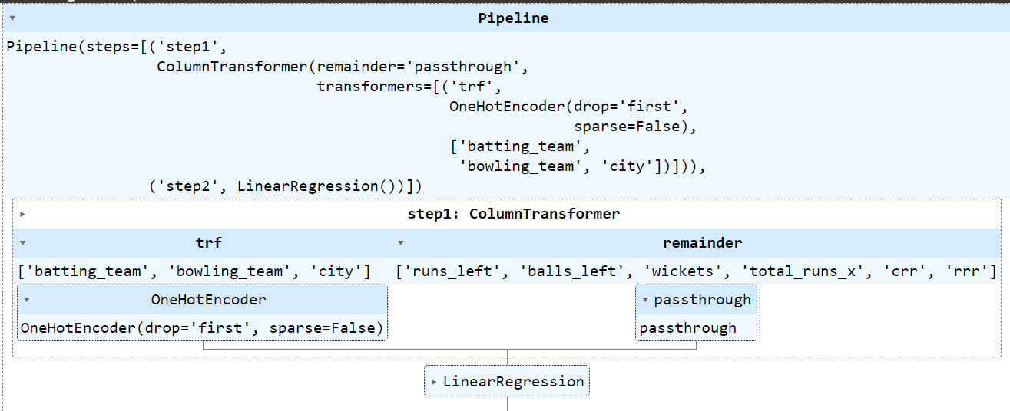
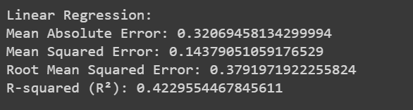
LINEAR REGRESSION MODEL

Slide 26
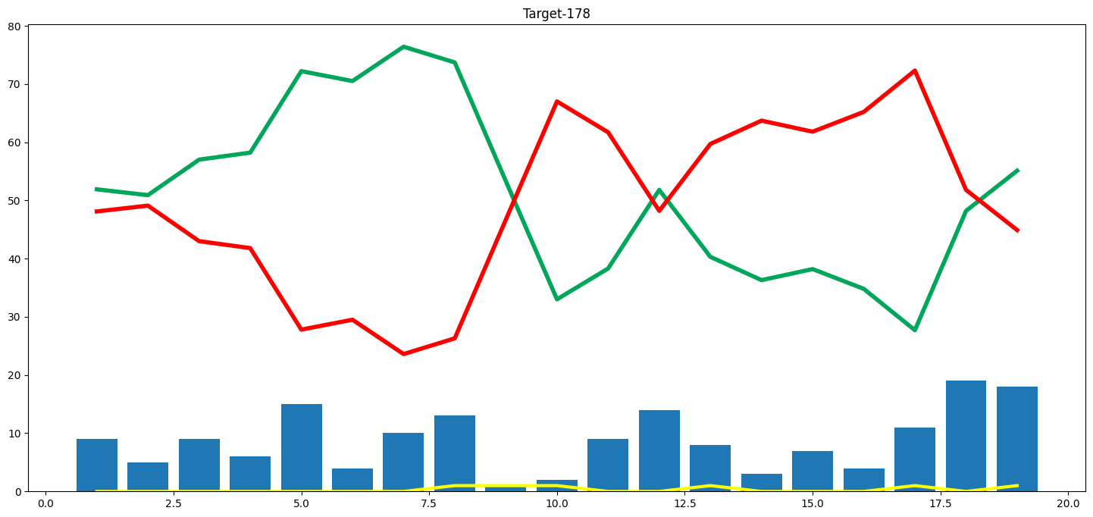

Slide 27
THANK YOU
LINK TO BLOG POST

